Slide 1
Class Enrollment System
GROUP-4
PHANINDHAR REDDY MAMIDI-700759484
AKSHAYA REDDY GOPIDI -700762484
UMESH REDDY GADDAM -700756326
MADHAN REDDY SINGIREDDY PATAK
-700773957

Slide 2
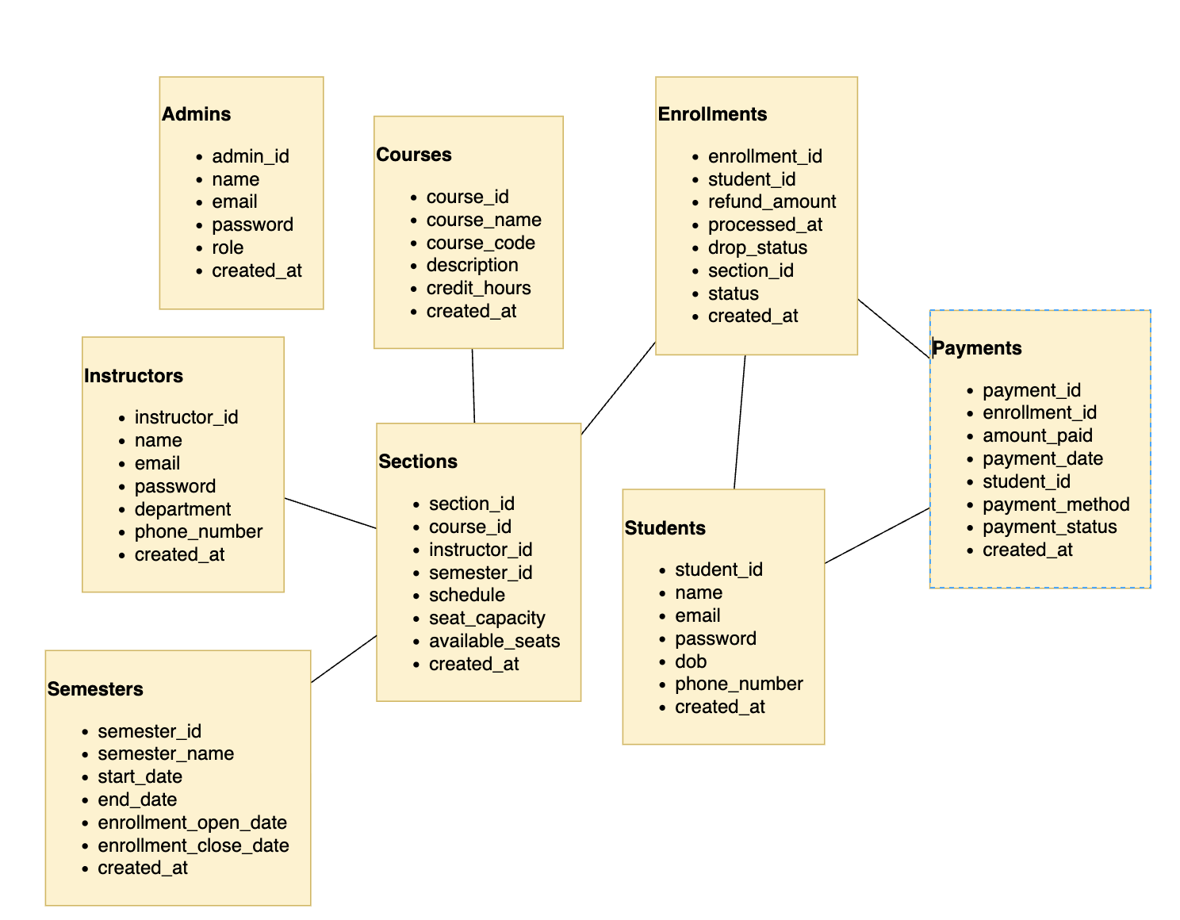
Database Schema

Slide 3
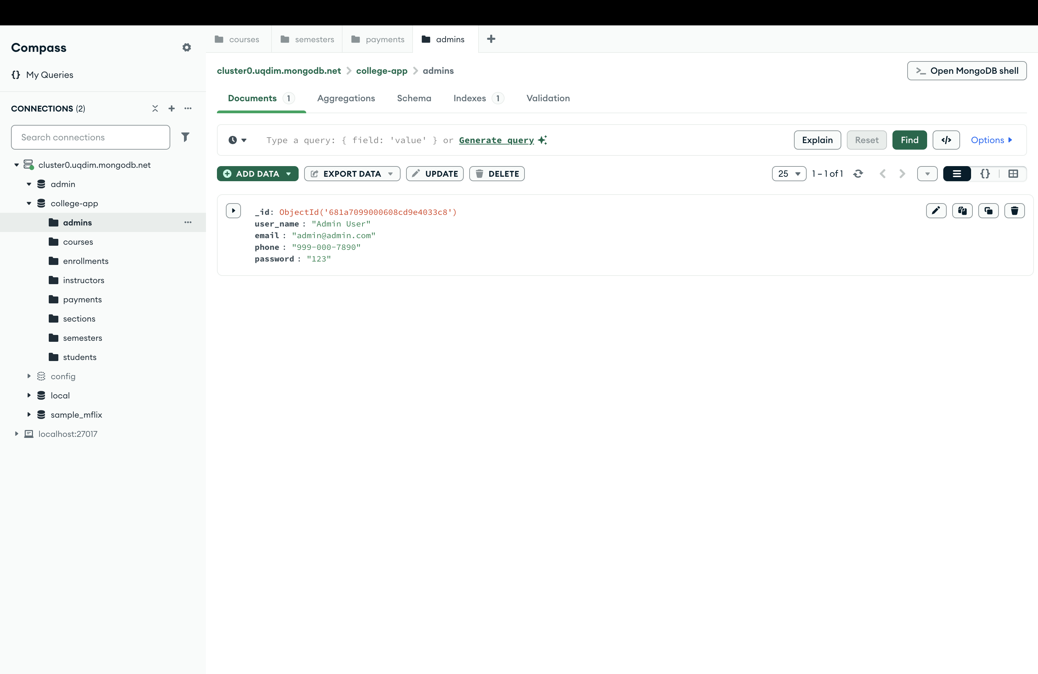
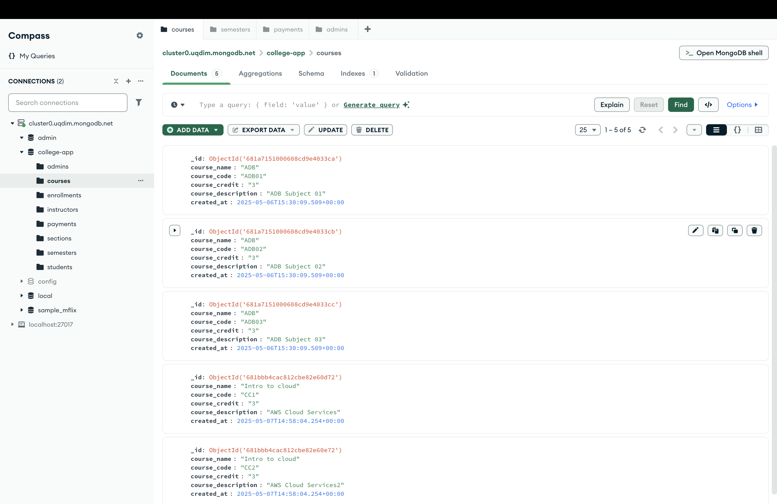
Database Screenshots
2

Slide 4
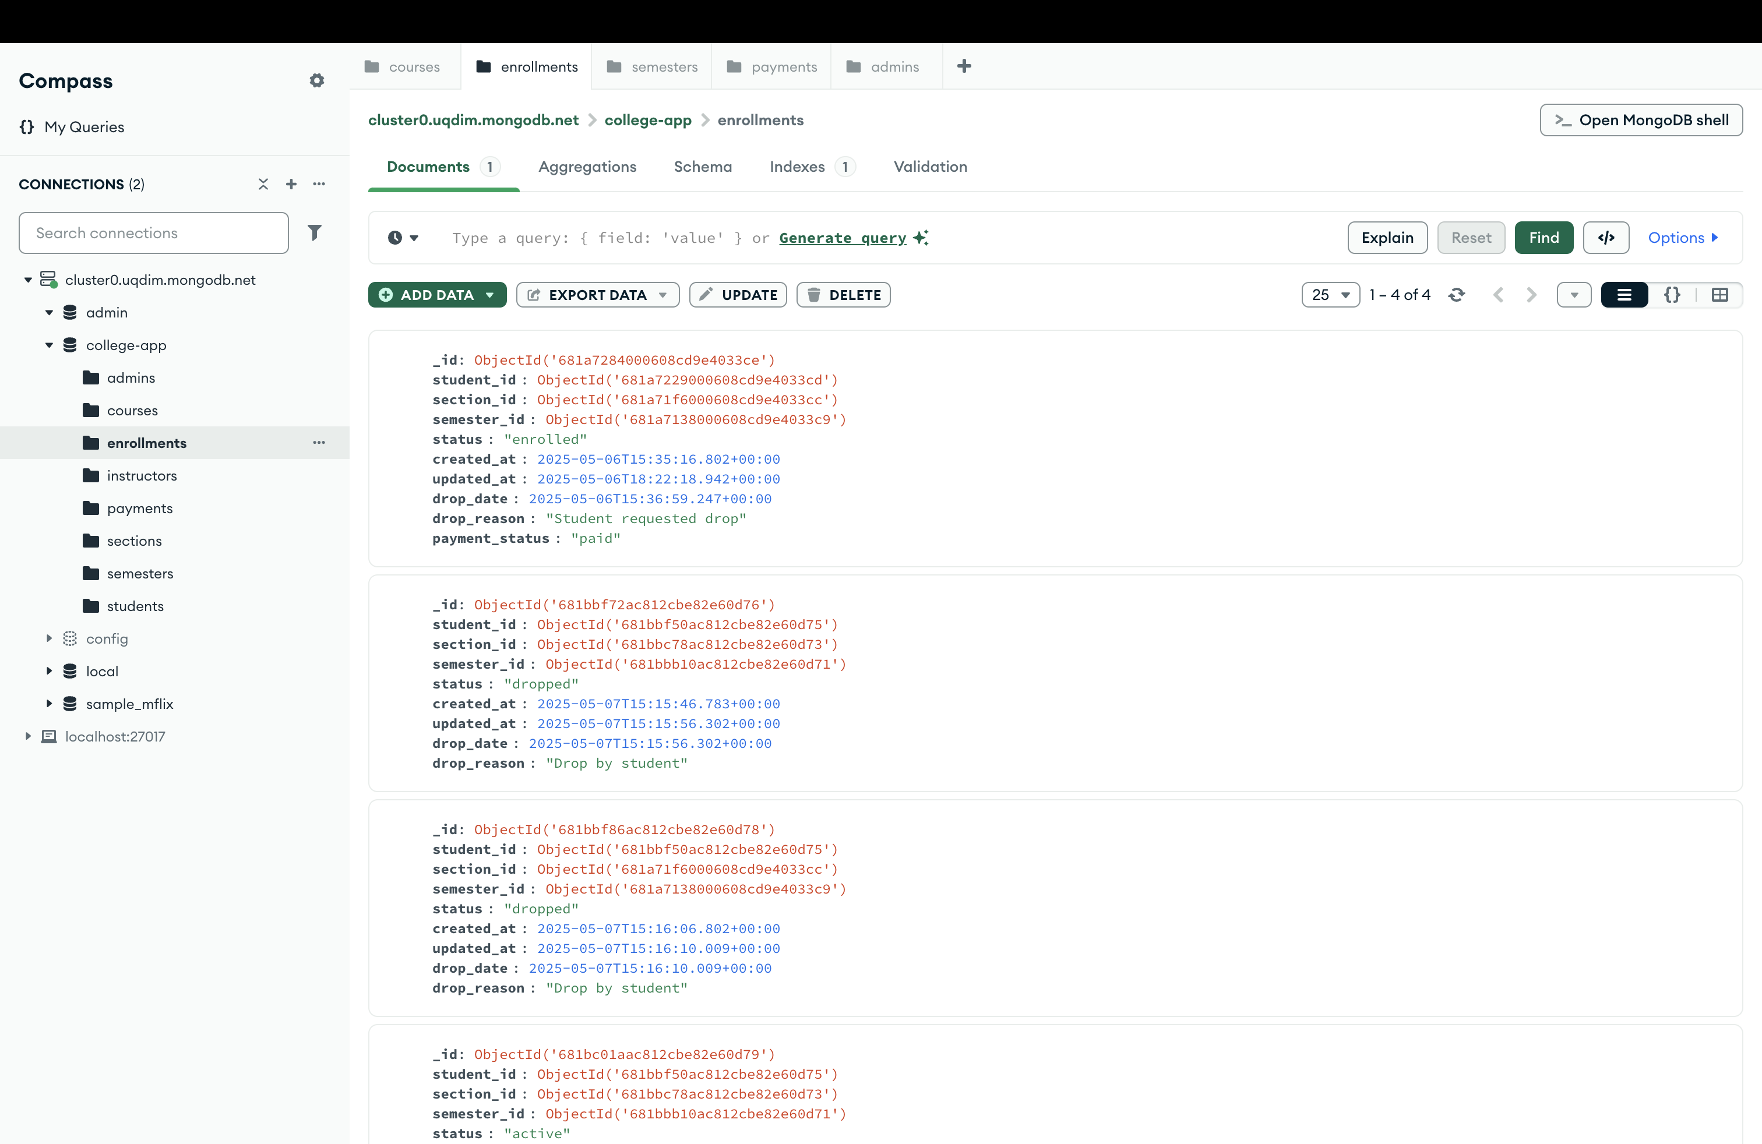
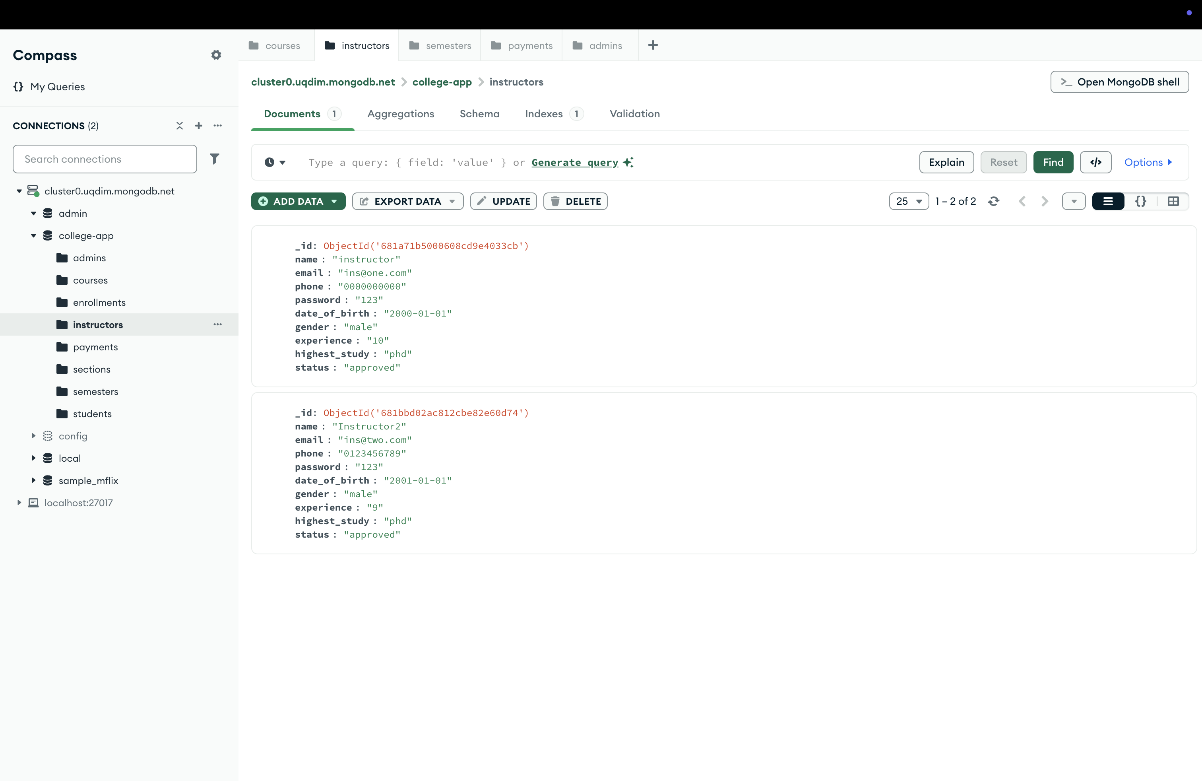
Database Screenshots

Slide 5
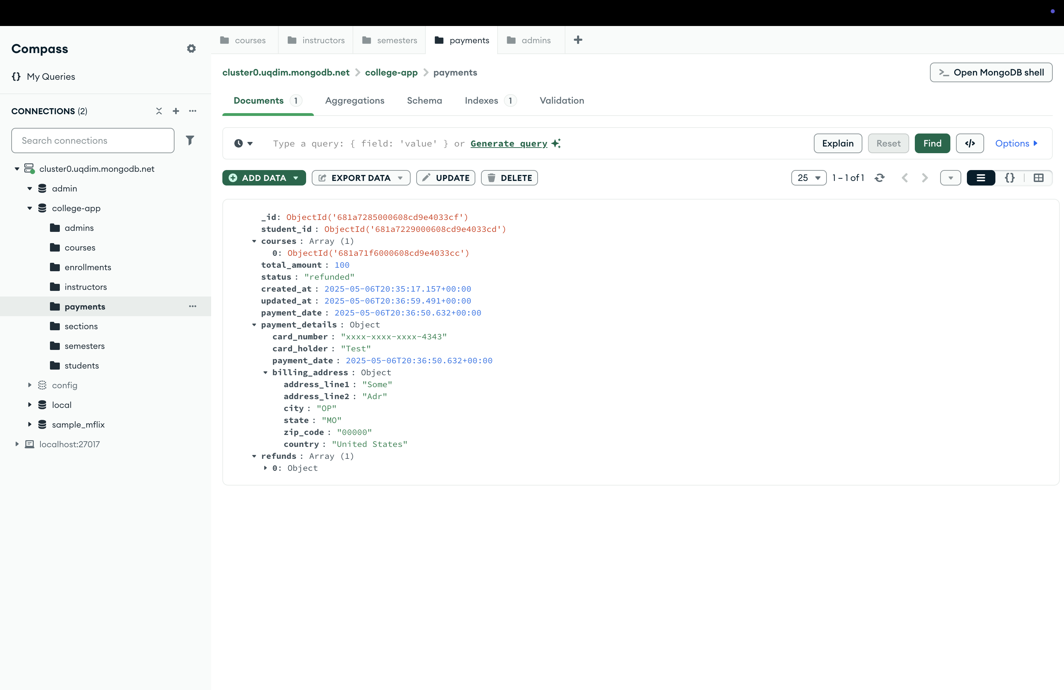
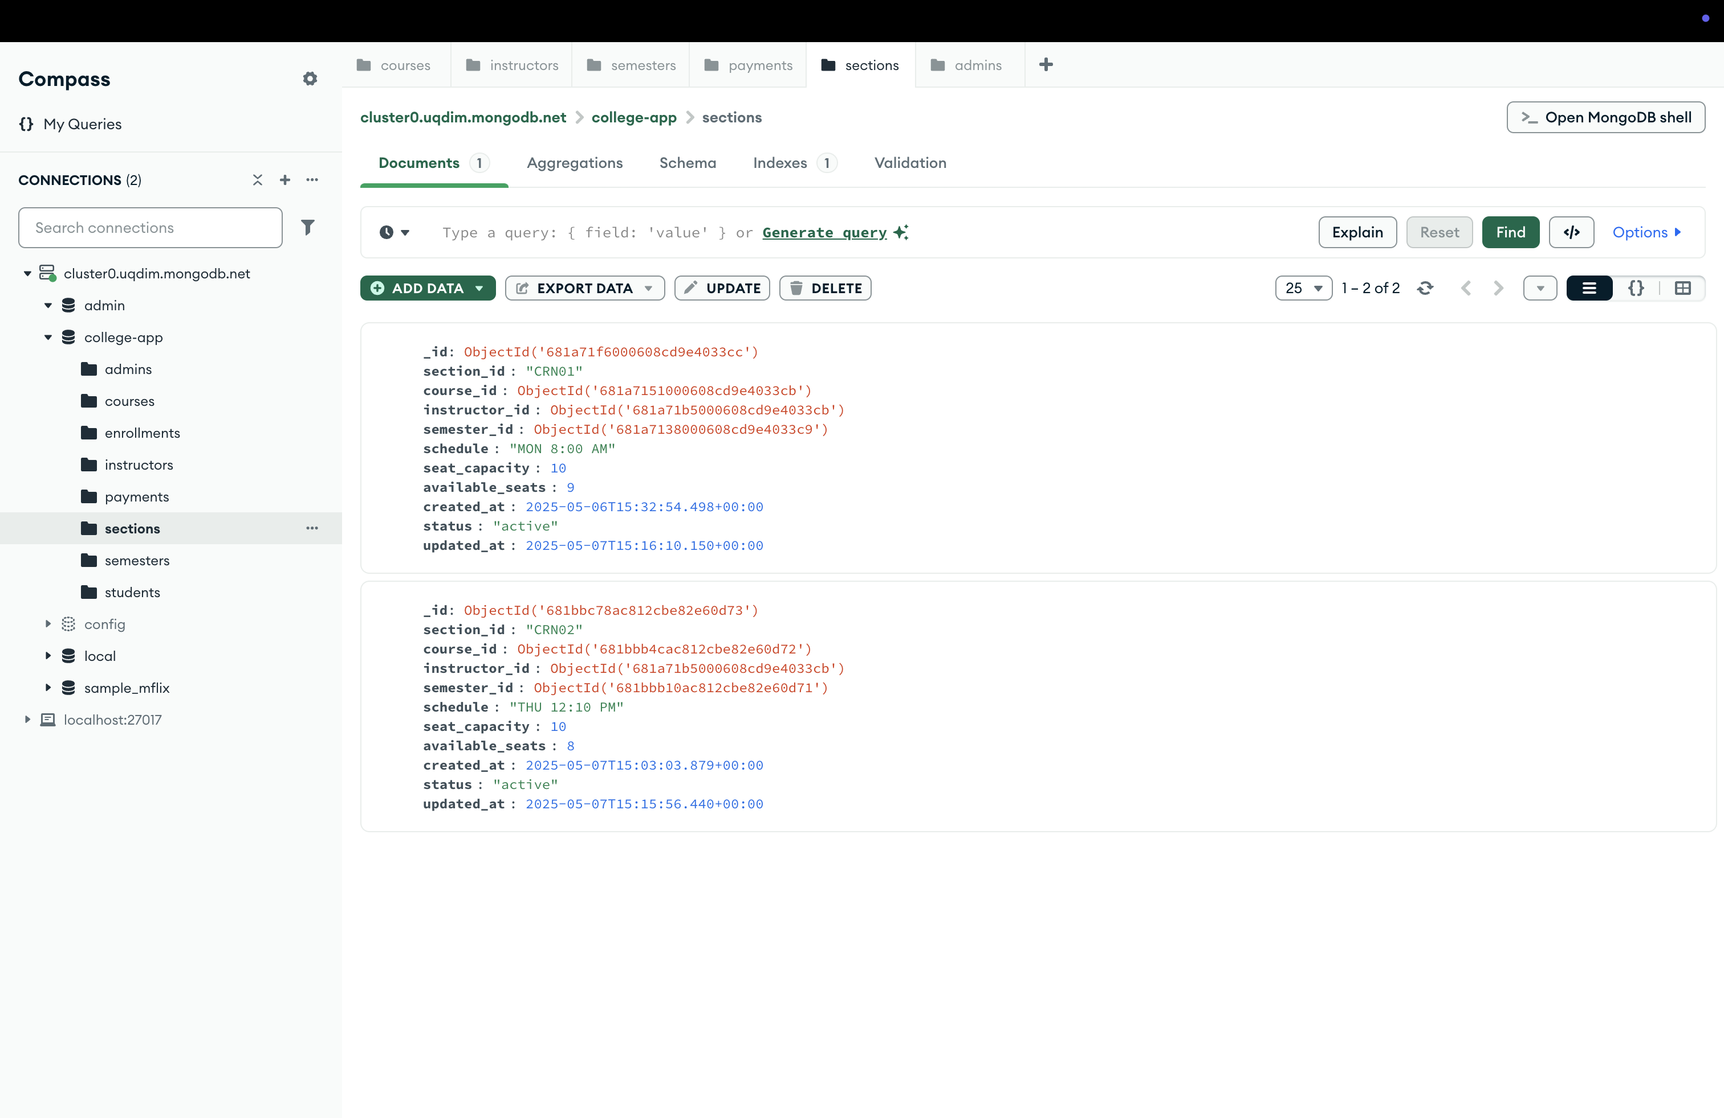
Database Screenshots

Slide 6
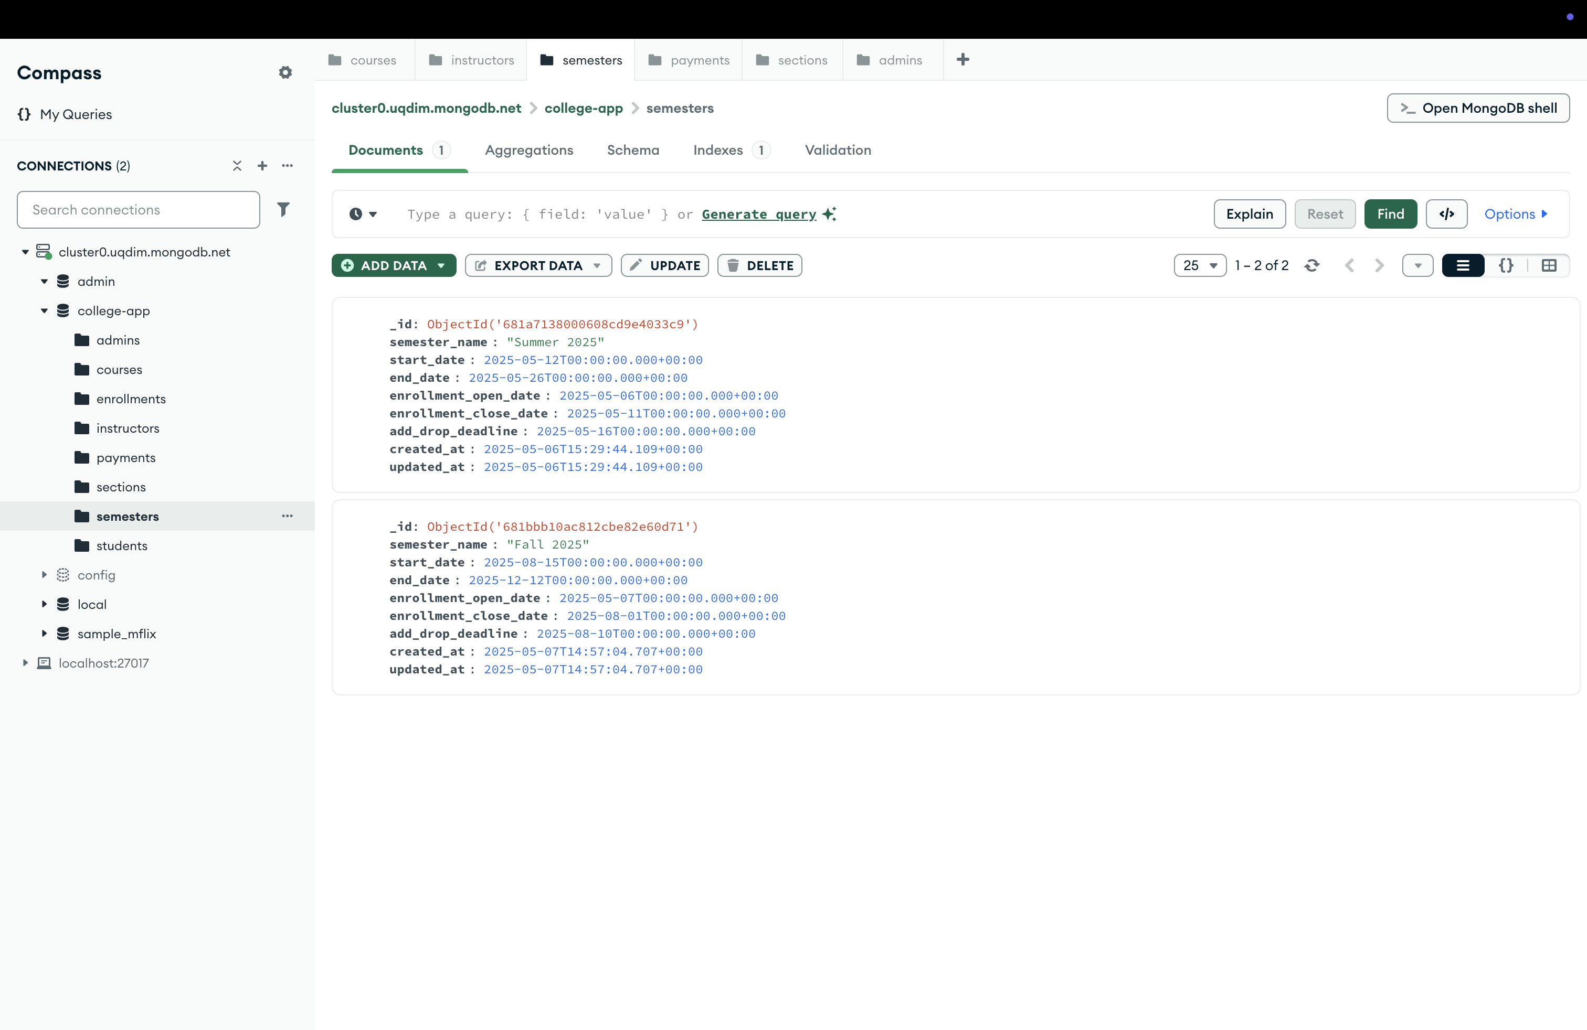
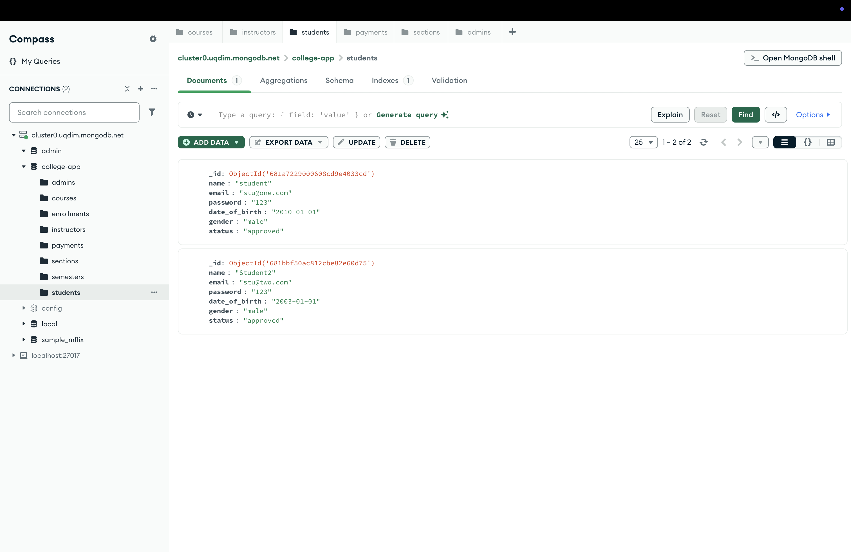
Database Screenshots

Slide 7
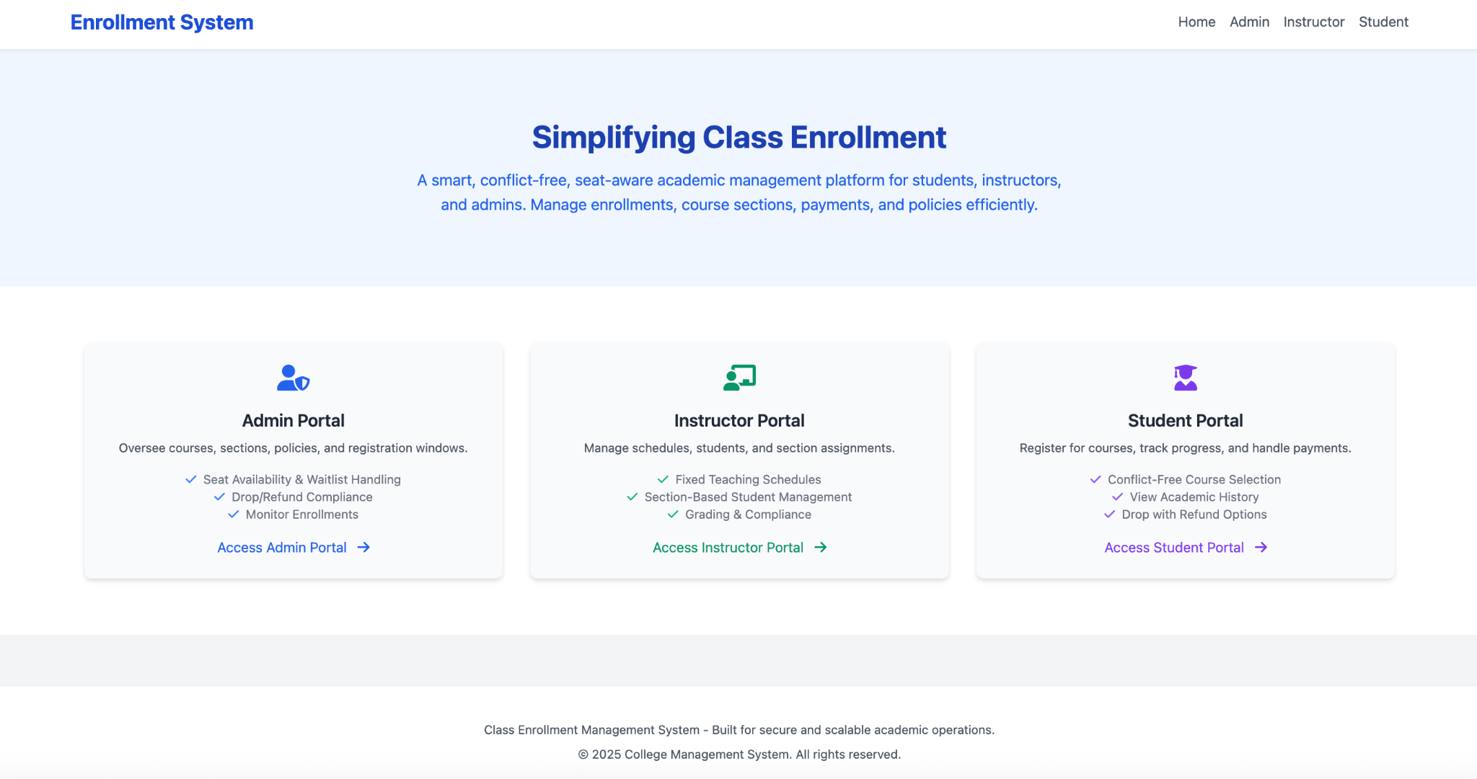
Application Screenshots

Slide 8
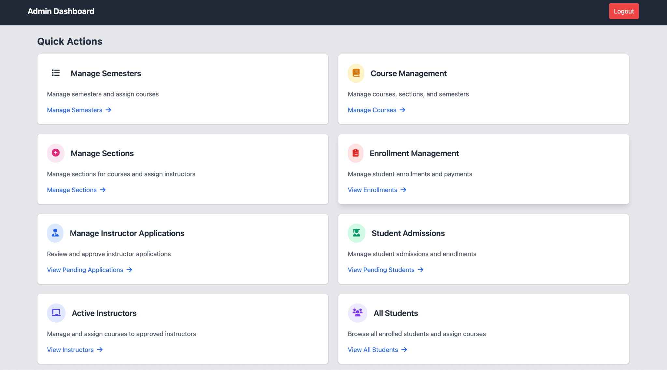
Admin Dashboard

Slide 9
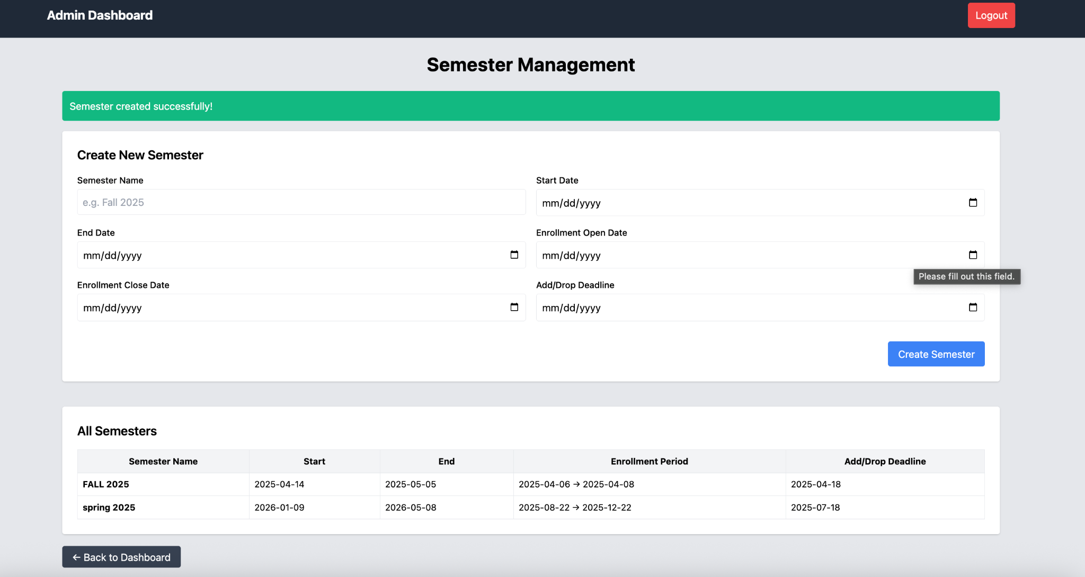
Semester Management Page - Admin

Slide 10
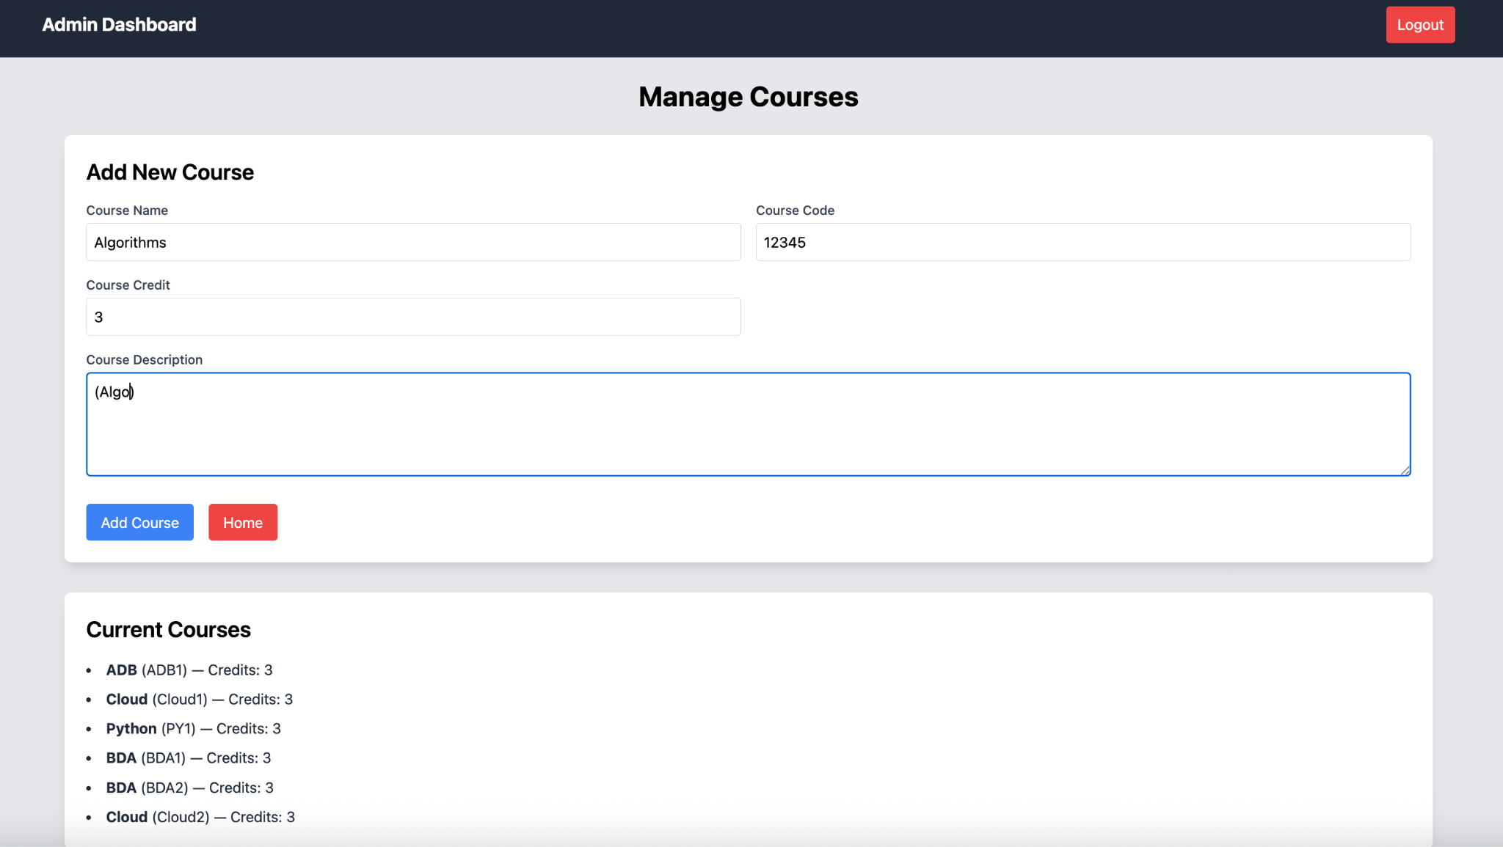
Manage Courses - Admin

Slide 11
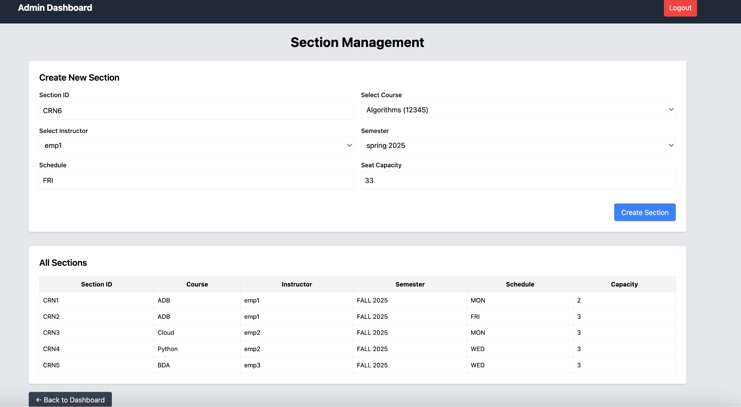
Section Management - Admin

Slide 12
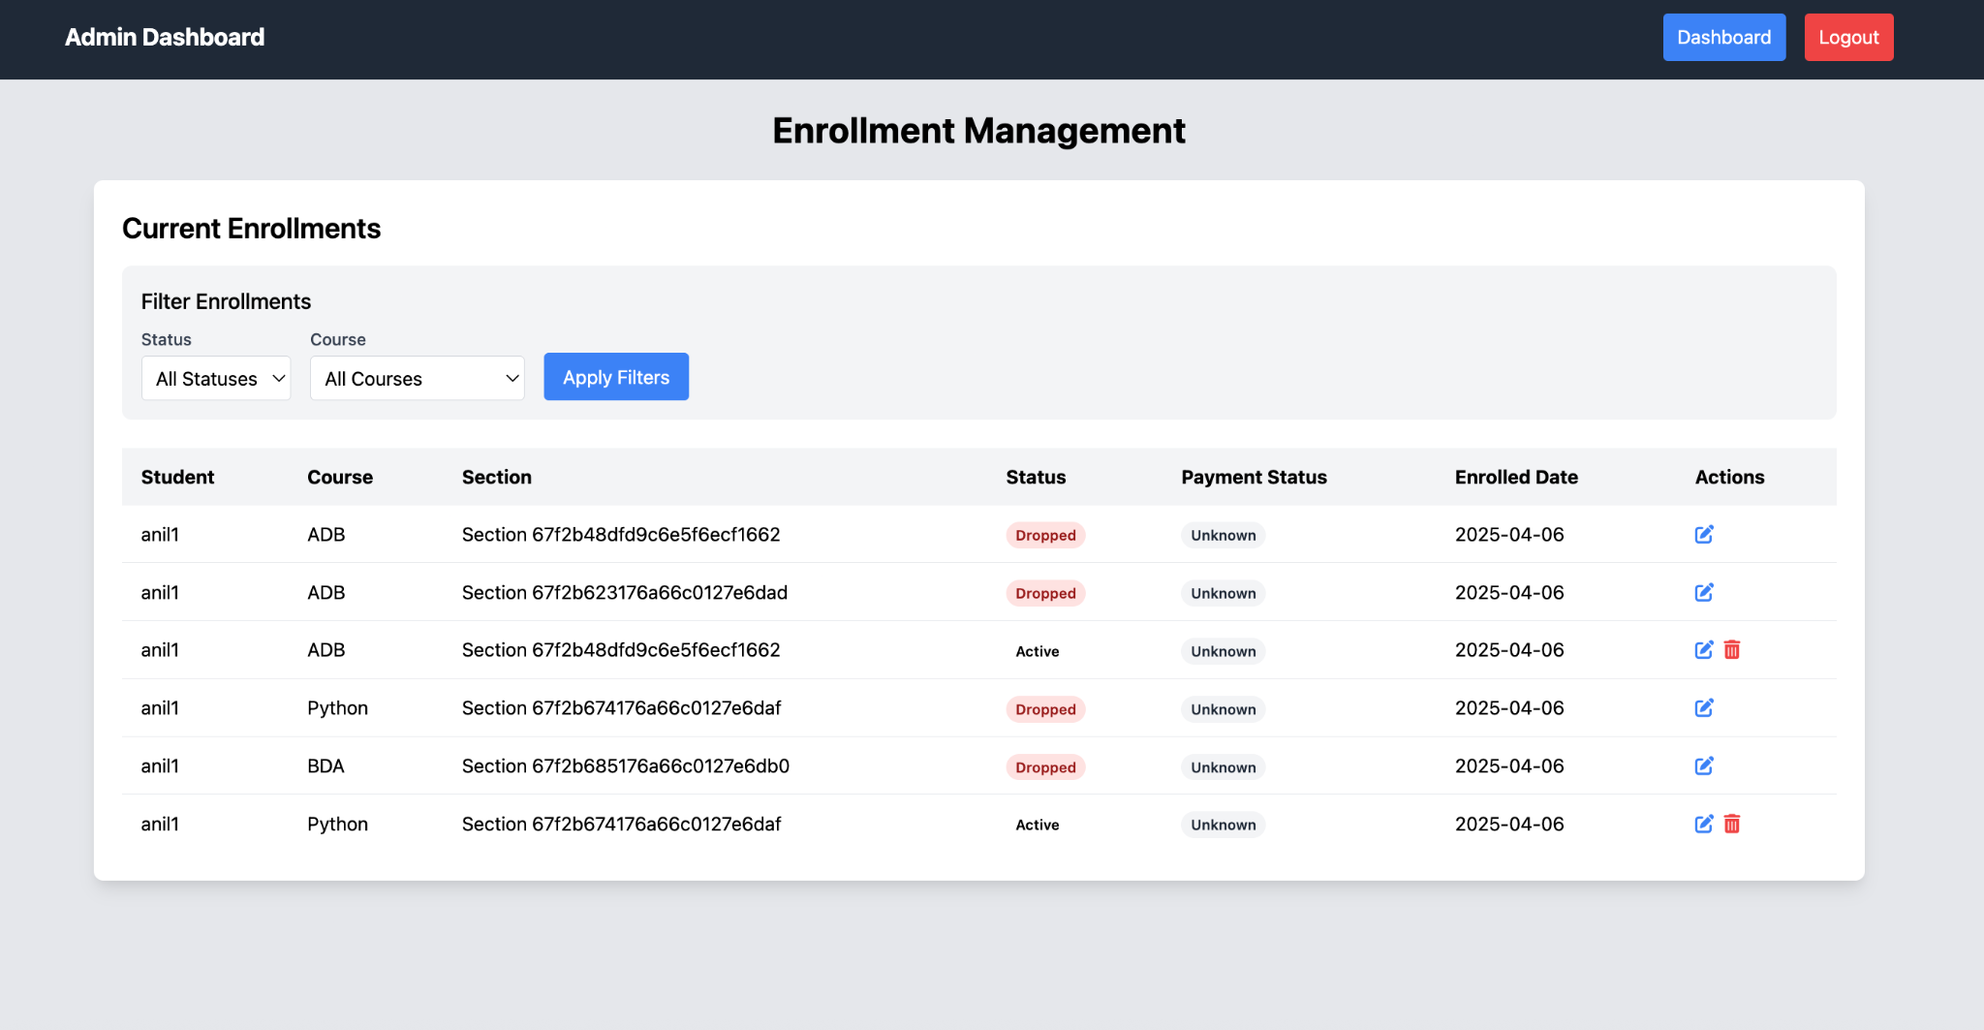
Enrollment Management - Admin

Slide 13
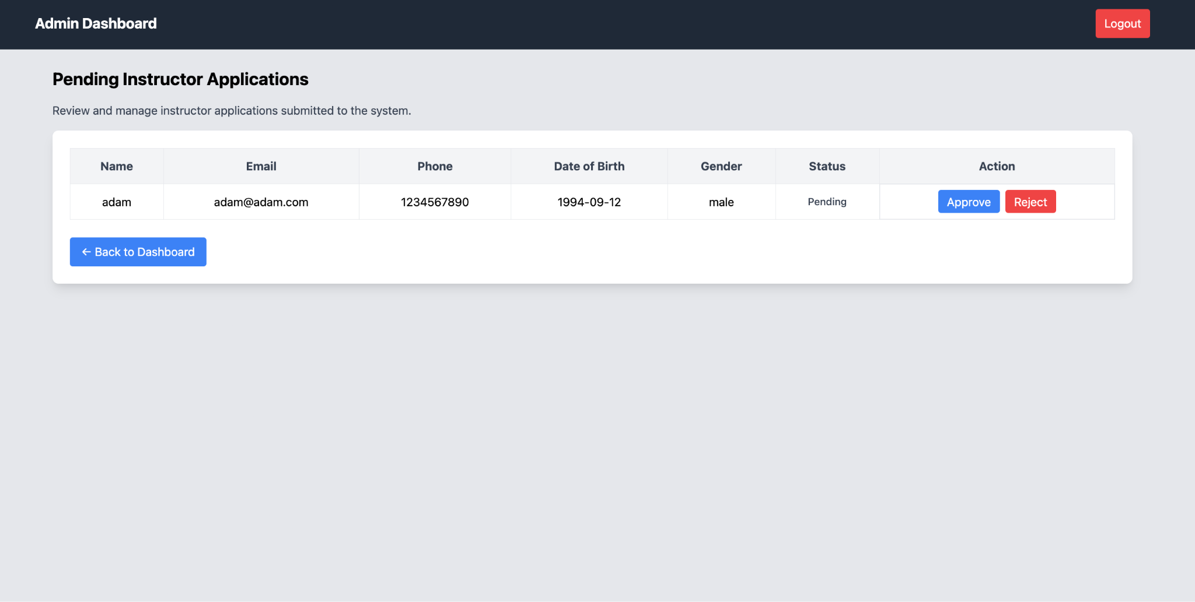
Instructors Applications Page - Admin

Slide 14
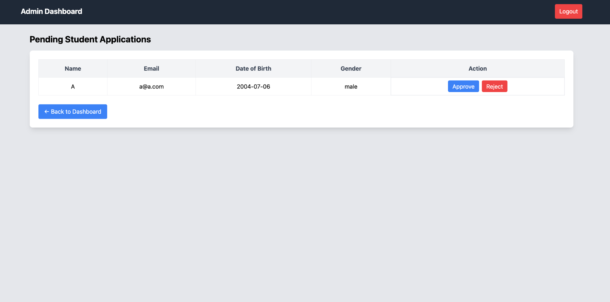
Student Applications Page - Admin

Slide 15
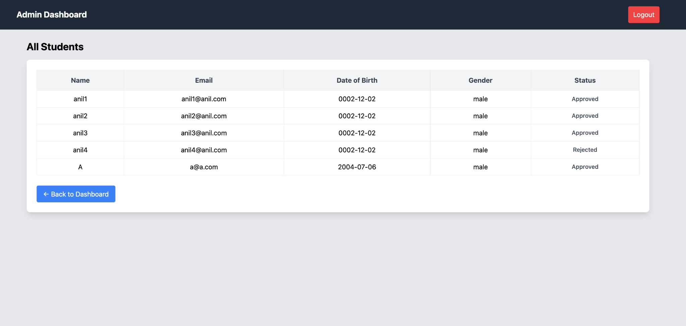
Student List Page - Admin

Slide 16
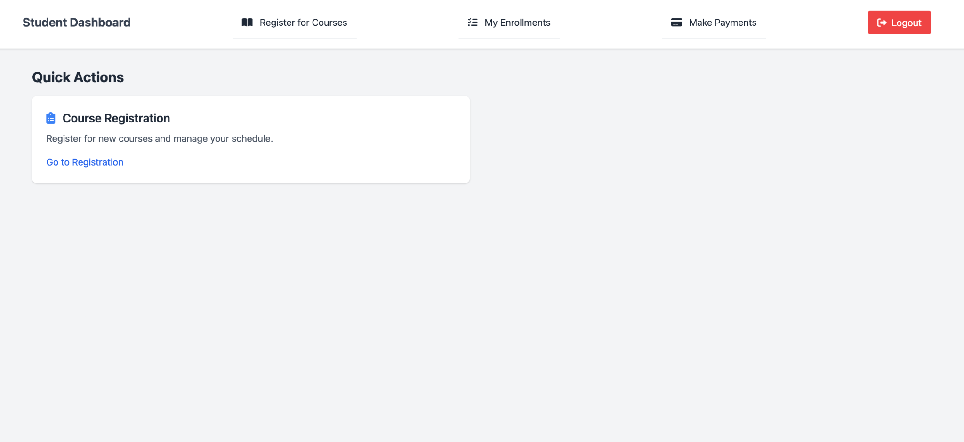
Student Dashboard - Student

Slide 17
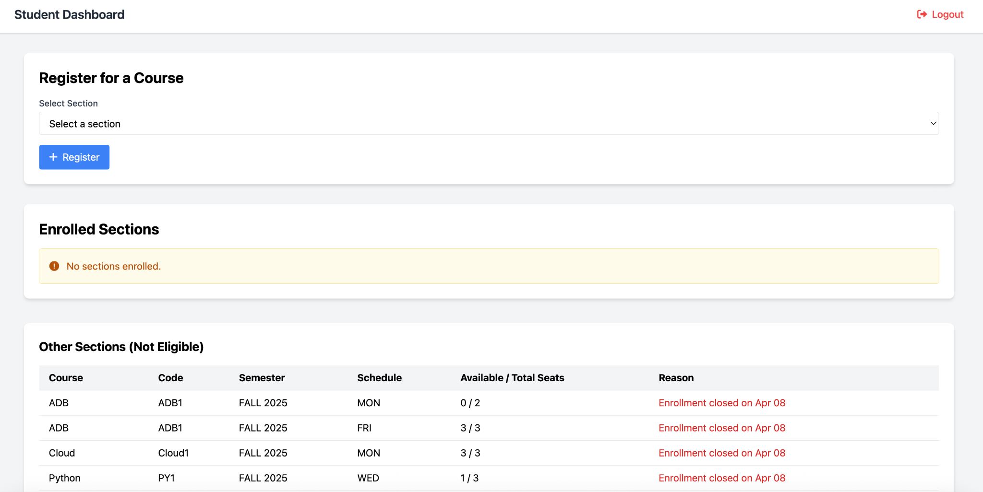
Register Course - Student

Slide 18
Register Course - Student

Slide 19
Thank You!!!!

